Slide 1
Brabbler AG
Microservices – TUM Course
April 2018

Slide 2

Who am I?
Enterprise Architect / Director of Software Engineering
Twitter: @keithballdotnet
Email: kball@brabbler.ag
https://www.brabbler.ag

Slide 3



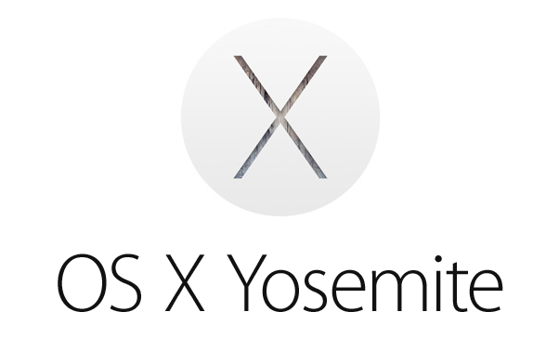
The Product
HIGHLIGHTS
All-in-one app, synced across devices
Fully encrypted – no exception
Integrated digital communication
Confidentiality and privacy from A to Z
My digital me. All that’s new combined in one comprehensive overview.
Address Book
Calendar
Integrated Messaging
File Management
Password Manager
My personal address book. All data about my contacts, also confidential information, safely stored and synced across devices.
My appointments at a glance and in detail. Plan, invite, share, and manage. All in one app and only accessible to me, no one else.
My communication unified. E-mail and chats – all in one interface. The same on all devices and 100% confidential.
The central place for important files. Accessible from any of my devices. Easy to share with others but always secure.
My passwords, PINs, credit cards, and other credentials securely encrypted. Always at hand on all my devices. Just for me.
B2B administration, configuration & management
Everything I need as an IT professional to roll out and operate the solution. With full data control and legal compliance.
Secure backup
A complete backup of the app and all your content. Securely saved and easily restored to any device. Fully encrypted, of course.

Slide 4
Microservices
Service Orientated Architecture (SOA++)
Small fine grained services
Loosely coupled
Modular
Domain Driven Design
Lots of patterns
Gateway
DB per service
...
Container per service

Slide 5
Orchestration
Borg / Kubernetes / Mesos / Swarm ...
Scheduling
Scaling
Automatic scaling?
Discovery

Slide 6

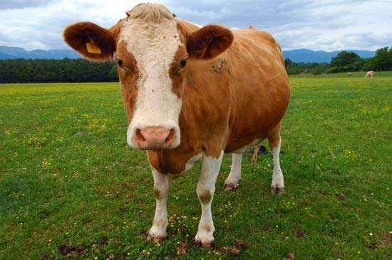
Pets vs Cattle

Slide 7
CI / CD
Continuous Integration
Small feature branches
Bias toward putting code into usage
Feature toggles

Slide 8
CI / CD
What does the D stand for in CD ?

Slide 9
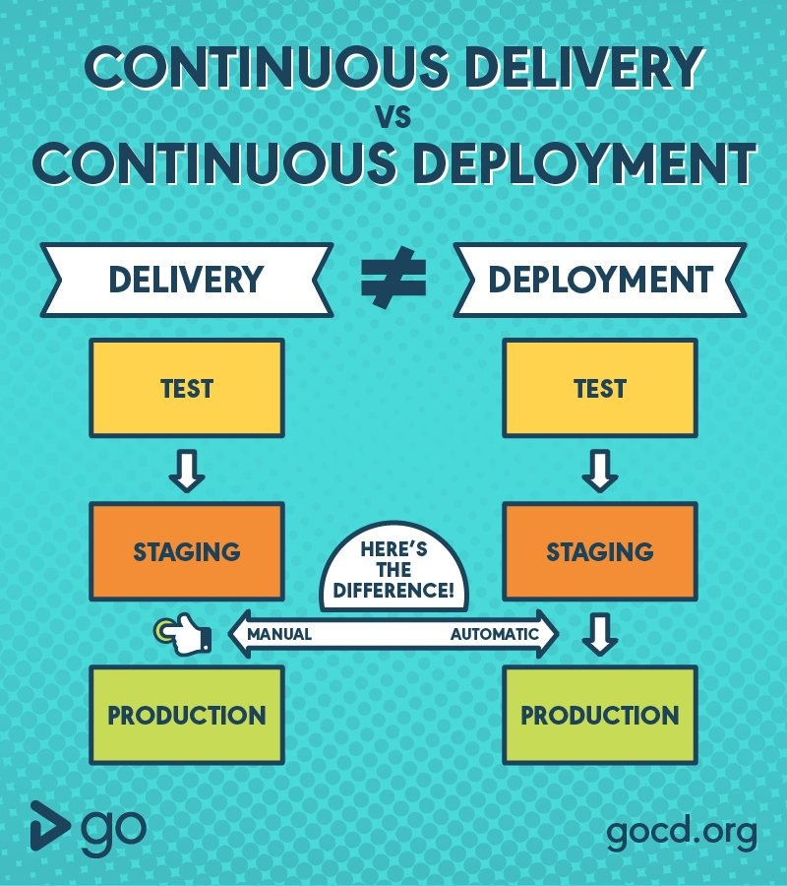
CI / CD

Slide 10
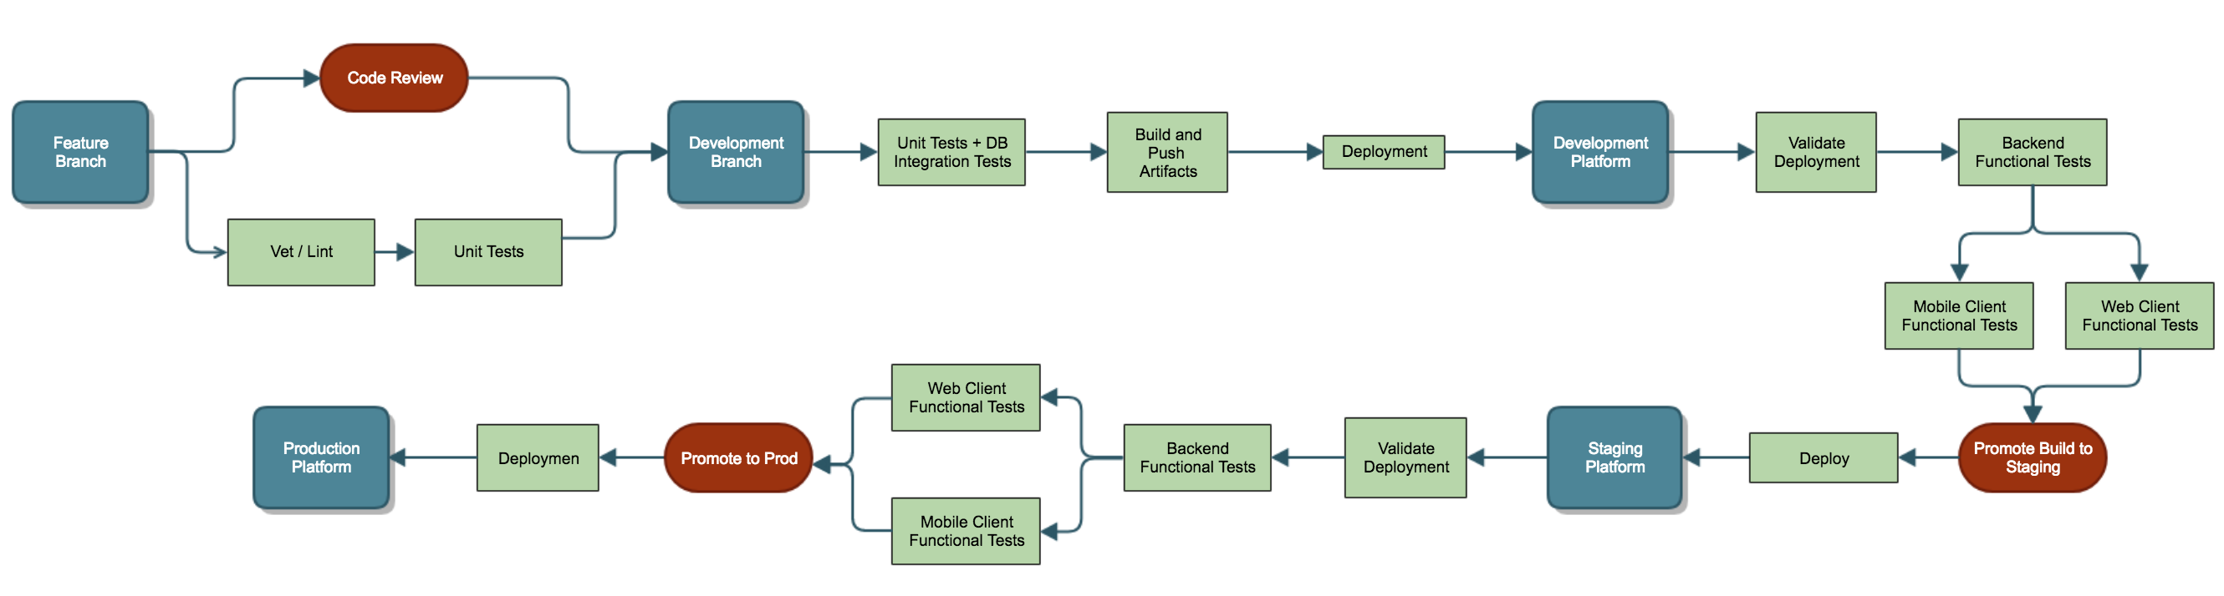
CI / CD @ Brabbler

Slide 11
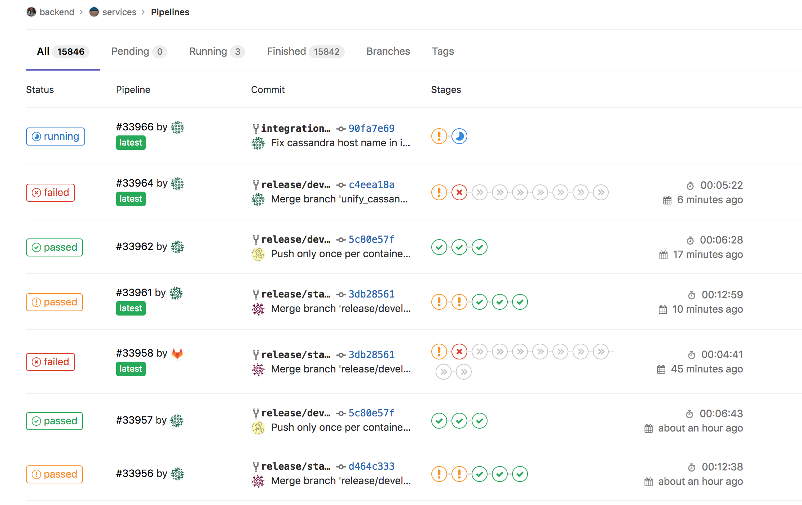
CI / CD @ Brabbler

Slide 12
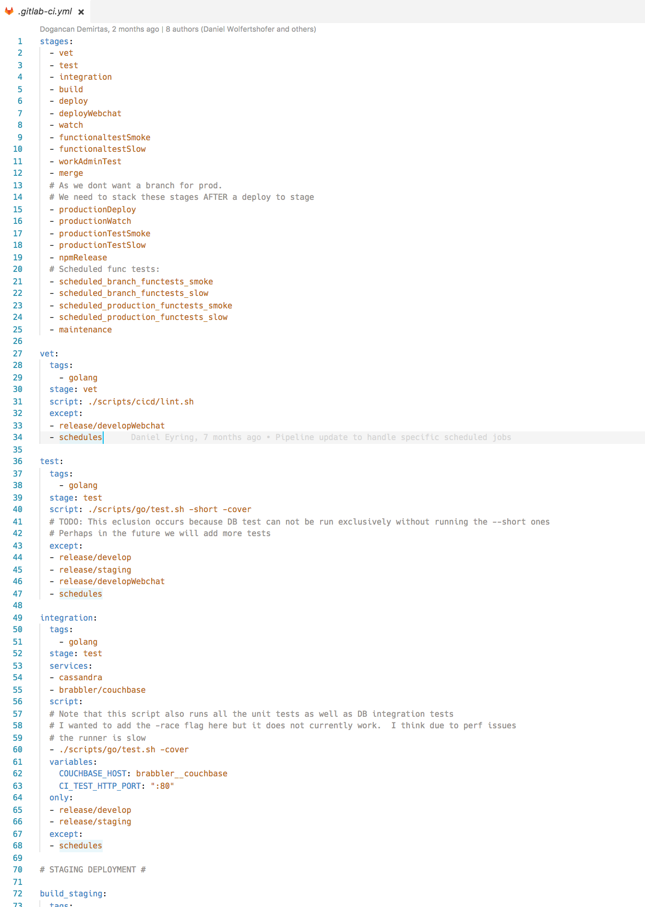
CI / CD @ Brabbler

Slide 13
CI / CD
https://github.com/keithballdotnet/objectsync
Free for open source projects!
https://travis-ci.org/keithballdotnet/objectsync

Slide 14
Hands On (part I) – Create a service
Create a basic web service in go

Slide 15
Hands On (part II) – Dockerize
Dockerize the service
Run it via docker
Kill it via docker

Slide 16
Hands On (part III) - Minikube
Start minikube
Check out node
Check out pods
Check out kubectl

Slide 17
Hands On (part IV) – Create first deployment
Create a hello.yaml file
Deploy it
Show that it is deployed
Test it

Slide 18
Hands On (part V) – Play with service
Delete a pod
Get logs from pods
Scale pods

Slide 19
Hands On (part VI) – 2 services
Woooo fun!

Slide 20
Thank you.

